Slide 1
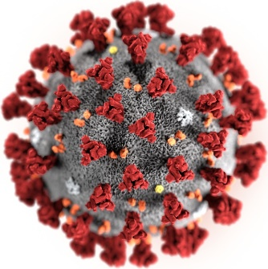
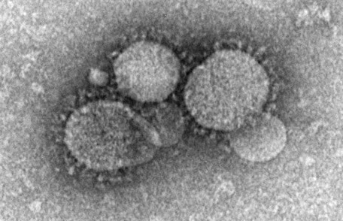
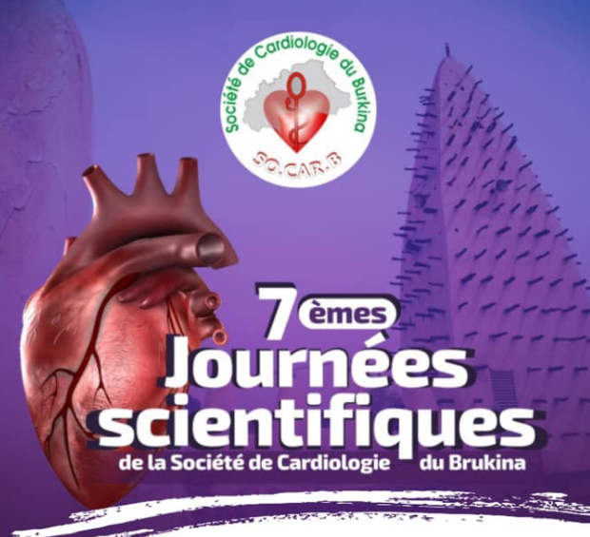






Complications Cardiovasculaires
et vaccination antiCOVID
Pr Franck Boccara (franck.boccara@aphp.fr)
Cardiologie, INSERM UMRS938
HUEP et CDR St Antoine, Sorbonne Universités, Paris, France
Président de la Nouvelle Société Francophone d’Athérosclérose (NSFA)
@BoccaraFranck
Assistance Publique
Hôpitaux de Paris

Slide 2
Sommaire
Physiopathologie de l’atteinte clinique
Vaccination antiCOVID et complications CV
Atteinte myocardique
Thrombose veineuse cérébrale

Slide 3
Physiopathologie
Tay MZ et al. Nature Rev Immunol 2020

Slide 4
Réponse immunologique : le cercle vertueux
Tay MZ et al. Nature Rev Immunol 2020

Slide 5
Marqueurs pronostiques

Slide 7
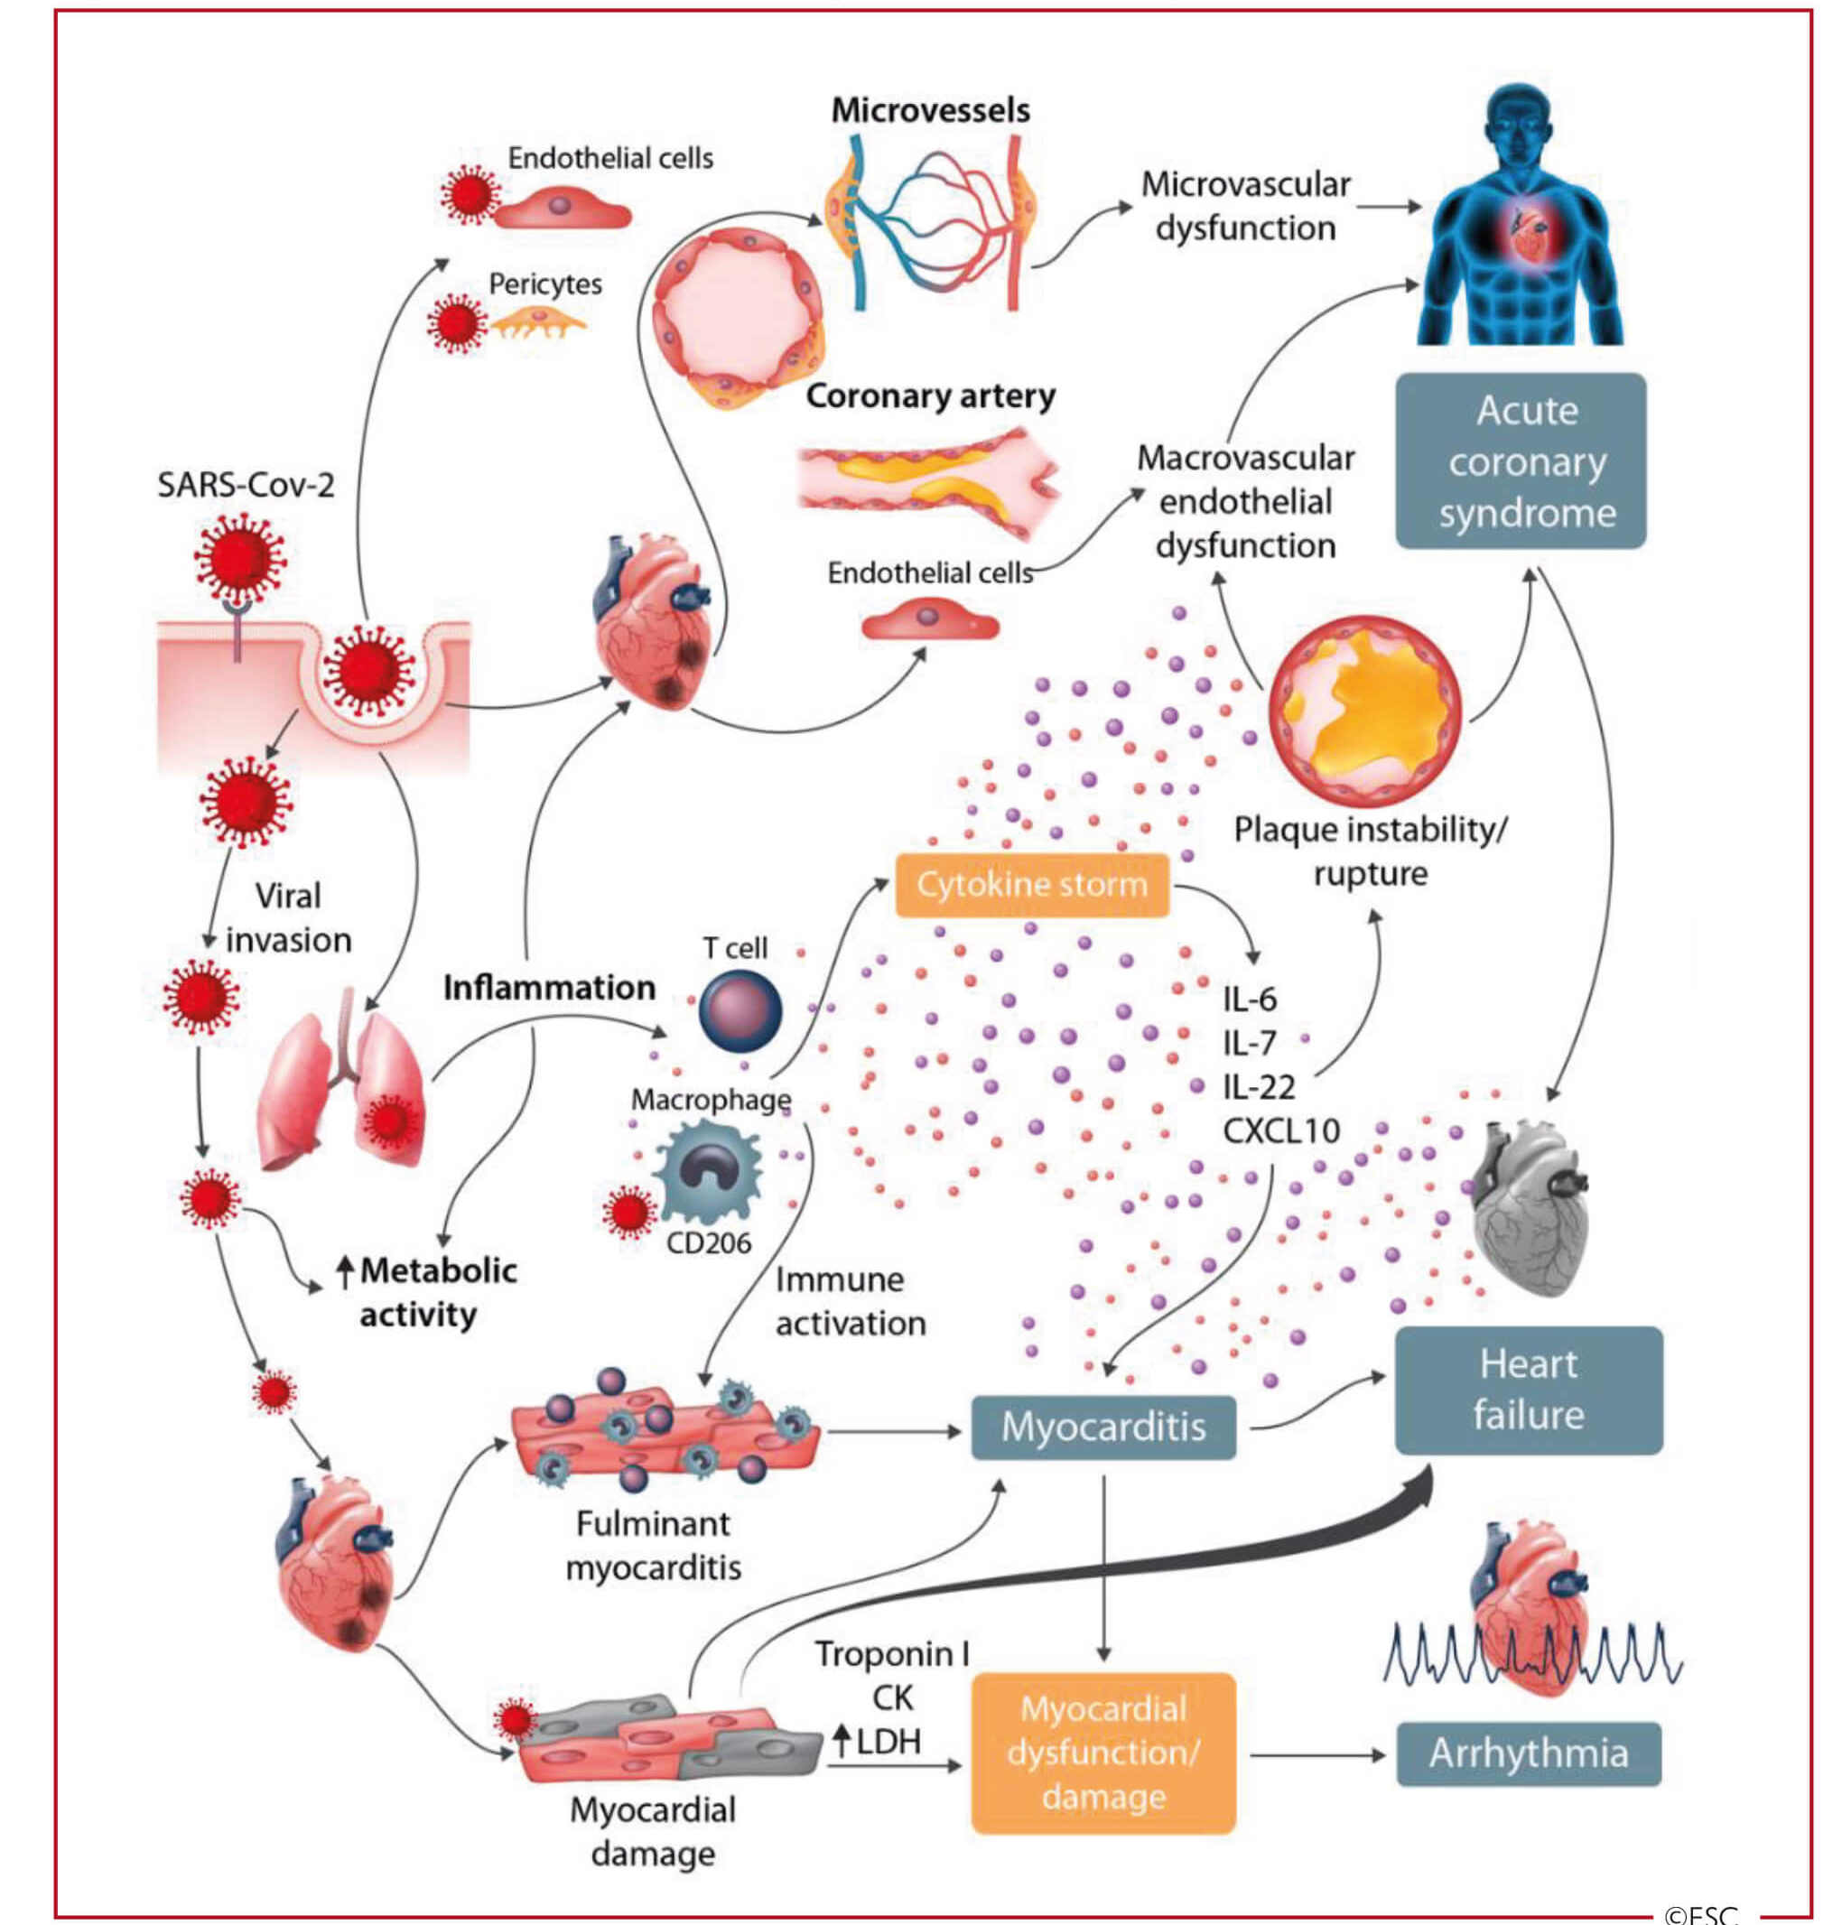

Manifestations cardiovasculaires de l'infection à SARS-CoV-2
Maladie cardiovasculaire secondaire au COVID
  Inflammation / syndrome de libération cytokinique
  Souffrance myocardique
  = risque accru de morbidité et de mortalité.
  Coagulopathie induite: TVP/EP
Toxicité cardiaque des médicaments antiviraux
Notes:
La physiopathologie de l'infection à coronavirus implique la liaison du SARS-CoV‑2 à un récepteur présent sur la cellule hôte pour faciliter sa pénétration : l’enzyme de conversion de l'angiotensine 2 (ACE2);
L’enzyme de conversion de l'angiotensine 2, exprimée dans les poumons, le cœur et les vaisseaux, est un élément clé du système rénine angiotensine aldostérone (SRAA) impliqué dans la physiopathologie de plusieurs maladies cardiovasculaires.
Les maladies cardiovasculaires associées au COVID-19 impliquent probablement un dérèglement du couple SRAA/ACE2 dû à l’infection par le SARS-CoV-2 et aux comorbidités, telles que l'hypertension artérielle
La maladie cardiovasculaire peut être primaire dans le COVID-19, mais peut être aussi secondaire au syndrome de détresse respiratoire aigu, qui entraîne une augmentation du travail cardiaque, potentiellement problématique chez les insuffisants cardiaques
Le syndrome de libération cytokinique, provenant d'un déséquilibre d'activation des cellules T avec une libération incontrôlée d'interleukine (IL)-6, IL-17 et d'autres cytokines, peut contribuer aux maladies cardiovasculaires dans COVID-19. Une thérapie ciblant l'IL-6 est en cours de test.
L'activation du système immunitaire ainsi que les altérations de la régulation métabolique immunologique peuvent entraîner une instabilité de la plaque athéromateuse, contribuant à la survenue d'événements coronariens aigus.

Slide 9
Endothélite?
Ç VML co-expriment ACE2 et TMPRSS2
Tant au niveau artériel ou veineux
Réponse immune innée → INFȲ → activation M1
→ IL1beta et IL6 → Activation endothéliale
Et augmentation expression des Maç
→ Aug exp° FT, PAI1
Giustino, G. et al. J Am Coll Cardiol. 2020;76:2011–23.
Notes:
Inflammatory cytokines and excessive Ang II activity lead to endothelial activation, which is associated with a prothrombotic phenotype and
increased endothelial permeability. In addition, SARS-CoV-2 has been shown to directly invade endothelial cells and cause endotheliitis.
Image created with BioRender.com. PAI ¼ plasminogen activator inhibitor; TF ¼ tissue factor; vWF ¼ von Willebrand factor; other abbreviations
as in Figure 1.

Slide 10
Myocardite postvaccinale

Slide 11
Myocardite et vaccination ARNm. France
VigiBase 25,728,751 adverse drug reaction reports
8664 myocarditis, 1251 involved a suspected culprit vaccine
. Amongthese latter reports, 214 (17.1%) were associated COVID-19 vaccines.
Only messenger ribonucleic acid (mRNA)COVID-19 vaccines, including mRNA1273 (Moderna®, n = 51,IC025= 1.1) and tozinameran (Pfizer/BioNTech®, n = 105,IC025= 0.05) were significantly associated with myocarditis, whereas other types of COVID-19 vaccine were not (Fig. 1).
median age of patients with COVID-19 vaccine-related myocarditis was 35 years (interquartile range 25—50years) and 131/205 (63.9%) were male
Associated pericarditis was reported in 47/214 (22%) cases. The median time to onset between last dose of vaccine received and the adverse event was 3 days (interquartile range 1—6days; n available = 202).
Notably, sufficient data were avail-able to classify 23 cases as definite, 16 as probable and 46 as possible myocarditis. No patient with definite myocarditis died.
Kerneis M. et al. ACVD 2021

Slide 12
Myocardite et vaccination ARNm. USA
1300 cases reported from more than 350 million doses in the United States
young men (median age 24 years), and nearly 2/3 of cases were reported after the second dose with a median onset of symptoms approximately three days after vaccination. For 18–24 year-old males, this translates to an expected prevalence of vaccine associated myocarditis that is approximately 3 cases per 100,000 doses (0.003%) based on VAERs data.
Prevalence of COVID-19 vaccine associated myocarditis at ~3 per 100,000 patients (0.003%) versus ~11 per 100,000 patients (0.01%) for acute COVID-19 myocarditis.
Fortunately, most case reports describing COVID-19 vaccine associated myocarditis have described a mild-to-moderate severity illness treated with supportive care, steroids, and/or non-steroidal anti-inflammatory drugs [4].
The reported prognosis for these patients appears to be good despite isolated cases with left ventricular systolic dysfunction.
B. Bozkurt et al. Circulation 2021;144:6;471–484.

Slide 13
Myocardite et vaccination ARNm. ISRAEL
136 diagnoses were definitive or probable of postvaccinal myocarditis.
The clinical presentation was judged to be mild in 129 recipients (95%); one fulminant case was fatal.
As compared with the expected incidence based on historical data, the standardized incidence ratio was 5.34 (95% CI, 4.48 to 6.40) and was highest after the second dose in male recipients between the ages of 16 and 19 years (13.60; 95% CI, 9.30 to 19.20).
The rate ratio 30 days after the second vaccine dose in fully vaccinated recipients, as compared with unvaccinated persons, was 2.35 (95% CI, 1.10 to 5.02); the rate ratio was again highest in male recipients between the ages of 16 and 19 years (8.96; 95% CI, 4.50 to 17.83), with a ratio of 1 in 6637.
CONCLUSIONS
The incidence of myocarditis, although low, increased after the receipt of the
BNT162b2 vaccine, particularly after the second dose among young male recipients.
The clinical presentation of myocarditis after vaccination was usually mild.
Myocarditis in the general unvaccinated population was
1 per 10,857 and can be compared with findings indicating that myocarditis was more common after SARS-CoV-2 infection than after vaccination,
as reported previously by Barda et al.
Mevorach D et al. NEJM 2021 Oct

Slide 14
Thrombose veineuse cérébrale

Slide 15
Thrombose veineuse cérébrale. USA
Europe ChAdOx1 nCoV-19 vaccine (Oxford/AstraZeneca), which uses a chimpanzee adenoviral vector.
Mechanism similar to autoimmune heparin-induced thrombocytopenia (HIT)
US, the Ad26.COV2.S COVID-19 vaccine (Janssen/Johnson & Johnson), which uses a human adenoviral vector,
April 12, 2021, approximately 7 million Ad26.COV2.S vaccine doses had been given in the US,
Case series of 12 US patients with CVST and thrombocytopenia following use of Ad26.COV2.S
Patients’ ages ranged from 18 to younger than 60 years; all were White women,
Seven patients had at least 1 CVST risk factor, including obesity (n = 6), nhypothyroidism (n = 1), and oral contraceptive use (n = 1); none had documented prior heparin exposure.
Time from Ad26.COV2.S vaccination to symptom onset ranged from 6 to 15 days.
Eleven patients initially presented with headache; 1 patient initially presented with back pain and later developed headache.
Of the 12 patients with CVST, 7 also had intracerebral hemorrhage; 8 had non-CVST thromboses.
After diagnosis of CVST, 6 patients initially received heparin treatment.
Platelet nadir ranged from 9 ×103/μL to 127 ×103/μL.
All 11 patients tested for the heparin-platelet factor 4 HIT antibody by enzyme-linked immunosorbent assay (ELISA)
screening had positive results. All patients were hospitalized (10 in an intensive care unit [ICU]).
As of April 21, 2021, outcomes were death (n = 3), continued ICU care (n = 3), continued nnon-ICU hospitalization (n = 2), and discharged home (n = 4).
See I. et al. JAMA 2021;325:24:2448-56.

Slide 16
Updated Recommendations from the Advisory Committee on Immunization Practices for Use of the Janssen (Johnson & Johnson) COVID-19 Vaccine After Reports of Thrombosis with Thrombocytopenia Syndrome Among Vaccine Recipients — United States, April 2021

Slide 17
Thrombose veineuse cérébrale. Internationale
Thrombosis with thrombocytopenia syndrome (TTS) has been reported after vaccination with the SARS-CoV-2 vaccines ChAdOx1 nCov-19 (Oxford–AstraZeneca) and Ad26.COV2.S (Janssen/Johnson & Johnson).
This cohort study used data from an international registry of consecutive patients with CVST within 28 days of SARS-CoV-2 vaccination ,included between March 29 and June 18, 2021, from 81 hospitals in 19 countries. Compared with CVST before COVID epidemic.
116 patients with postvaccination CVST, 78 (67.2%) had TTS, of whom 76 had been vaccinated with ChAdOx1 nCov-19; 38 (32.8%) had no indication of TTS.
The control group included 207 patients with CVST before the COVID-19 pandemic.
A total of 63 of 78 (81%), 30 of 38 (79%), and 145 of 207 (70.0%) patients, respectively, were female, and the mean (SD) age was 45 (14), 55 (20), and 42 (16) years, respectively. Concomitant thromboembolism occurred in 25 of 70 patients (36%) in the TTS group, 2 of 35 (6%) in the no TTS group, and 10 of 206 (4.9%) in the control group, and in-hospital mortality rates were 47%(36 of 76; 95%CI, 37-58), 5%(2 of 37; 95%CI, 1-18), and 3.9% (8 of 207; 95%CI,2.0-7.4), respectively.
The mortality rate was 61% (14 of 23) among patients in the TTS group diagnosed before the condition garnered attention in the scientific community and 42%(22 of 53) among patients diagnosed later.
In this cohort study of patients with CVST, a distinct clinical profile and high mortality rate was observed in patients meeting criteria for TTS after SARS-CoV-2 vaccination with high rates of coma and intracerebral hemorrhage and a high mortality rate.
Sánchez van Kammen M. et al. JAMA Neurol. 2021

Slide 18
Key messages Thrombose veineuse cérébral et vaccination AZ et JandJ
Rare complication des vaccins avec vecteur adenovirus
Manifestation entre j4 et J24 après vaccination sujet < 60a et femmes
Cause immunologique (Ac antiPF4)→ thrombose avec thrombocytopénie.
Symptomes : céphalés s’aggravant. Vertige, fatigue, troubles visuels, deficit neurologique focal et signes HIC.
CAT: D-dimers, tx de plaquettes, HIT-2
IRM cerebral angioIRM pour confirmer TVC (T2 image du caillot)
URGENCE BIOLOGIQUE ET IMAGERIE
Anticoagulation et immunomodulation

Slide 19
HTA

Slide 20
HTA et SARSCOV2

Slide 21
HTA et SARSCOV2

Slide 22
HTA et SARSCOV2

Slide 23
HTA et SARSCOV2

Slide 24
HTA et SARSCOV2

Slide 25
Conclusions
Actions direct et indirect du virus SARSCOV2 sur le cœur en raison de l’inflammation, de l’activité endothéliale et de la thrombose microvasculaire.
Ce qui determine l’extension de l’atteinte CV c’est la charge virale, la réponse immune et la presence de comorbidités.
Rares cad de myocardite inférieur au taux de myocrdite lié au SARSCOV2
Très rares cas de TV cérébrale bien inférieur aux cas d’EP/TVP liés au SARS COV2

Slide 26
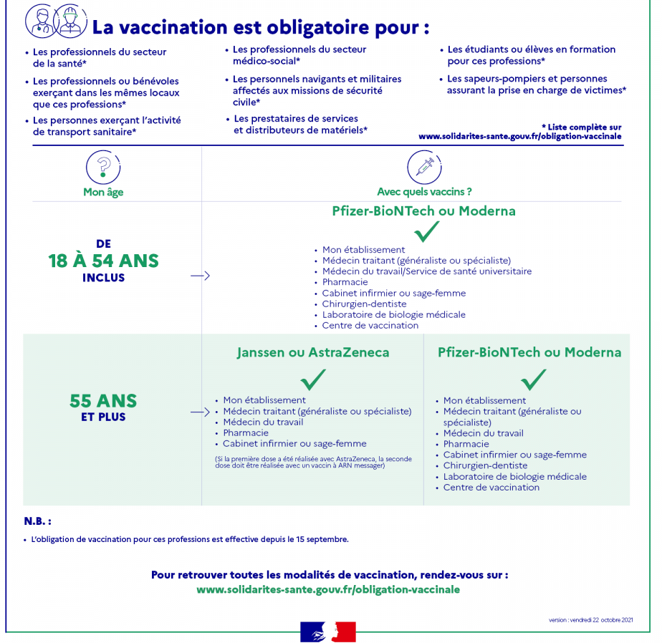

Slide 27
